Slide 1

VesselSegNet:A Deep Learning Framework for Autonomous Retinal Blood Vessel Segmentation on Fluorescein Angiography Scans
By
Vishal Balaji Sivaraman

Slide 2



Agenda
Project Overview
Proposed Model & Algorithm Summary
Project Outcome & Demo

Slide 3
Project Overview
Introduction
Objective
Dataset Description

Slide 4
Introduction

Slide 5
Introduction
The retina is the light-sensitive layer located in the back of the eye that enables vision. In addition, the retina gets oxygen and nutrients from the retinal blood vessels and the choroid.
A majority of illnesses pertaining to the eye is caused either by retinal blood vessels being leaky or obstructed .As a consequence of this the corresponding section of the vision field will be impaired.
This occurrence is generally known as an occlusion. There are many conventional deep learning algorithms to examine and procure critical information regarding blood vessels in the retina, but none is more popular than a fully connected convolutional autoencoder, often known as UNet.

Slide 6
Objective

Slide 7
Objective
Short term Objective
To automate the identification and isolation of retinal blood vessels with simplicity and effectiveness.
Long term Objective
To develop an application/tool to assist doctors and surgeons in comprehending the blood flowing through these blood vessels for issue diagnosis.

Slide 8
Dataset Description

Slide 9
Dataset Description
In this research, a custom database for segmenting retinal blood vessels was developed by integrating multiple prominent open-source datasets to promote heterogeneity and flexibility.
In addition, the datasets 'ARIA', 'ChaseDB', 'DR-Hagis', 'DRIVE', 'HRF', 'IOSTAR', and 'ORVS' were employed for model training and testing, whilst the dataset 'STARE' [7] was utilized for model validation.

Slide 10
Dataset Description
Moreover, each discrete dataset employed form model training comprises of approximately 20 to 30 exceptional fluorescein angiography (fundus) scans with their respective masks spread across the folders titled train and test respectively, resulting in a custom training database housing approximately of 760 fluorescein angiography (fundus) scans and their corresponding masks for model analysis.
Finally, the dataset dubbed 'STARE' comprises of roughly 397 exemplary fluorescein angiography (fundus) scans from which five fundus scans selected at random make up the validation database for model validation.

Slide 11
Proposed Model & Algorithm Summary
Model Description
Data Modelling & Augmentation
Proposed Model Architecture
Proposed Algorithm Workflow Chart
Proposed Model Framework
Data Loader Overview
Proposed Algorithm Design
Model Metrics

Slide 12
Model Description

Slide 13
Model Description
The suggested architecture is based on a fully convolutional network, which has been modified and enhanced to operate with less training images and provide more precise segmentations, thereby augmenting our understanding about the region of interest.
Furthermore, its unique architecture provides precise localization, making it preferable than a typical convolutional neural network.
Moreover, the suggested network provides critical features such as compatibility, customizability, adaptability, and much more , thereby making it more attractive to machine learning researchers in the field of Medical Imaging.

Slide 14
Proposed Model Framework

Slide 15

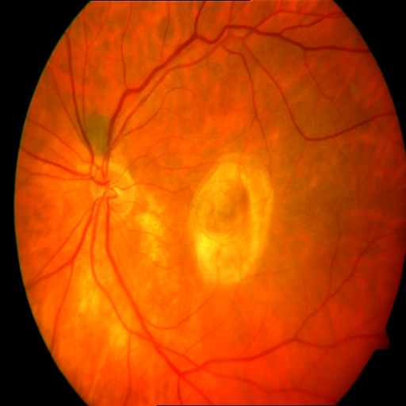
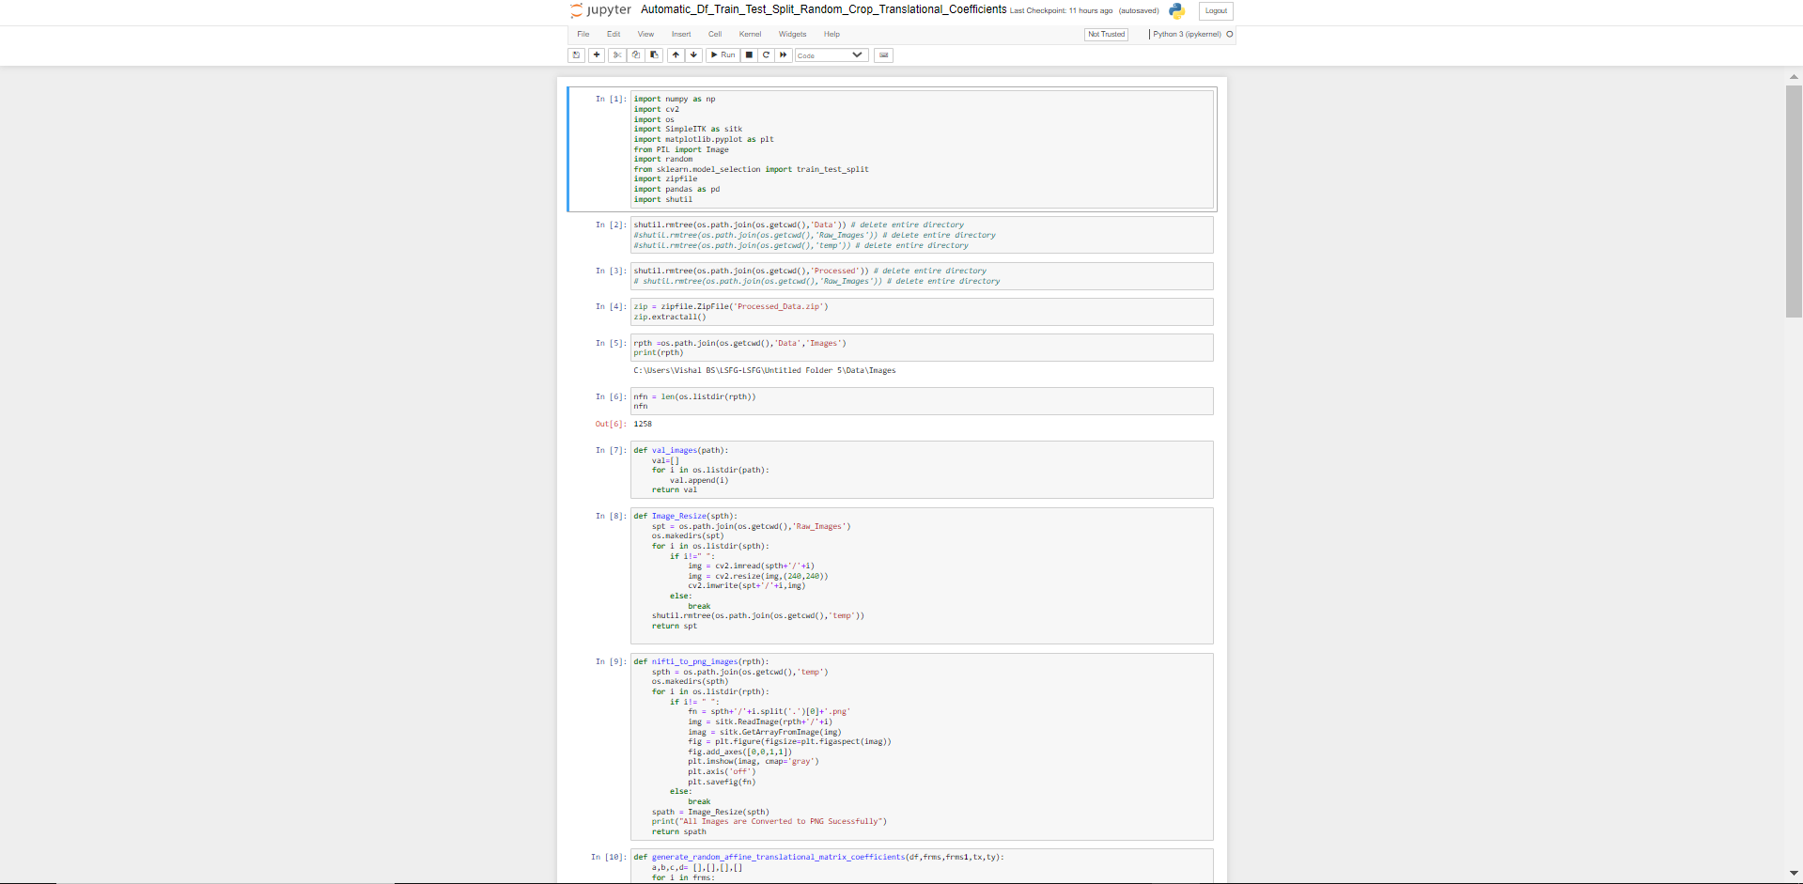
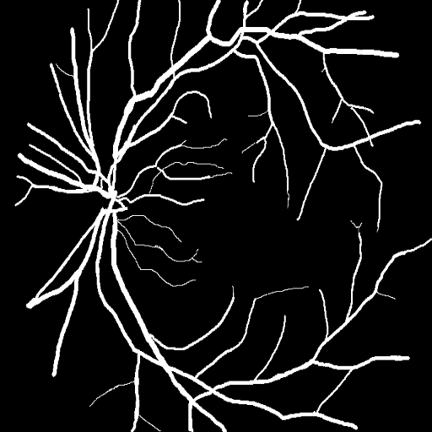

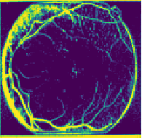
Proposed Model Framework
Image
Image
Pre-processing
UNet Model
Prediction
Model
Params
Values
Computation of Metrics
Mask

Slide 16
Data Modelling & Augmentation

Slide 17
Data Modelling & Augmentation
Data modelling is essential for training a deep learning framework prior to deployment. Moreover, the steps are outlined below.
Initially the images and its corresponding masks spanned across the datasets were resized to an uniform size of 512*512 respectively.
Concurrently , the resized images and their corresponding masks were also converted to RGB and Greyscale before being saved with a universal file extension titled ‘Portable Network Graphics’ or PNG separately.
Moreover, the steps were implemented in order to ensure data uniformity prior to model training and validation.

Slide 18
Data Modelling & Augmentation
Furthemore, the preprocessed images and its corresponding masks were introduced to a list of data transformation techniques titled Horizontal Flip, Vertical Flip, Elastic Transform, Grid Distortion & Optical Distortion, respectively .
This step is performed in order to exploit the symmetric nature of the images and its corresponding masks ,thereby augmenting the model’s ability to comprehend and generalize, respectively.
Finally, the step labeled data augmentation was only applied to the datasets labelled for model training and validation and not real time validation (RTV) respectively.

Slide 19
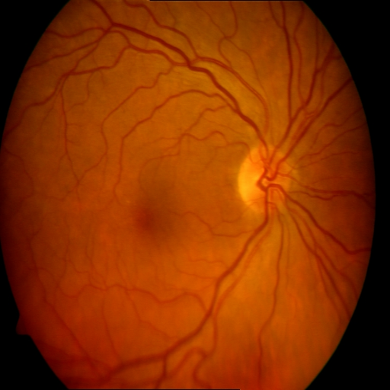
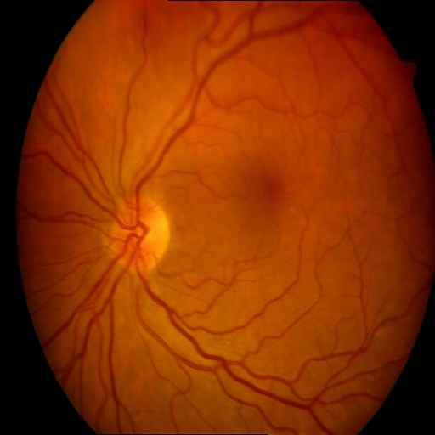
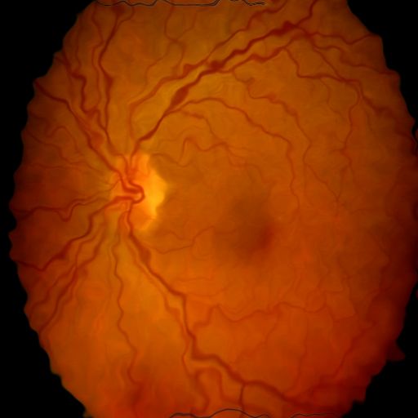
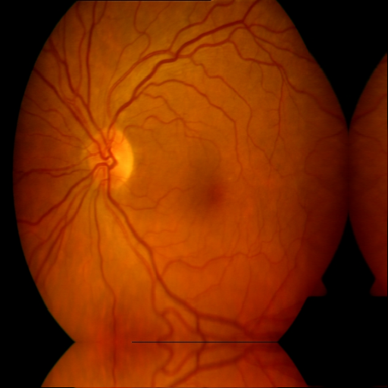
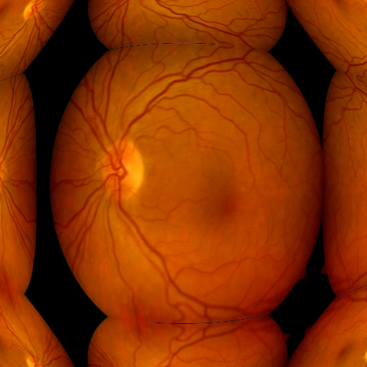
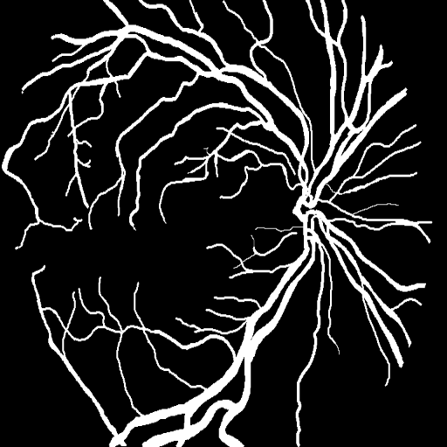
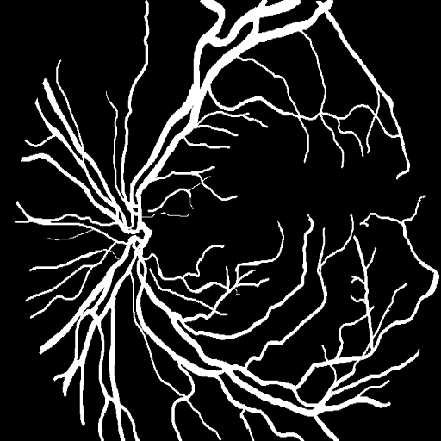
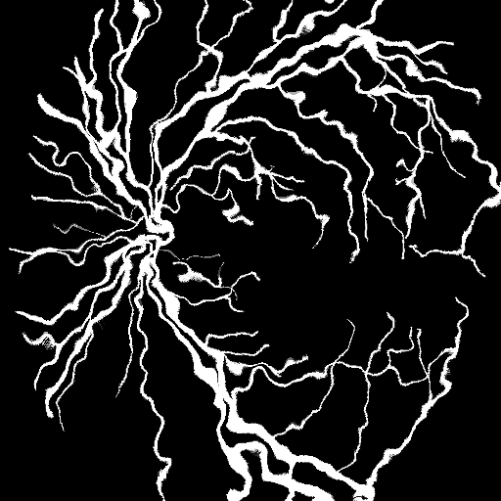
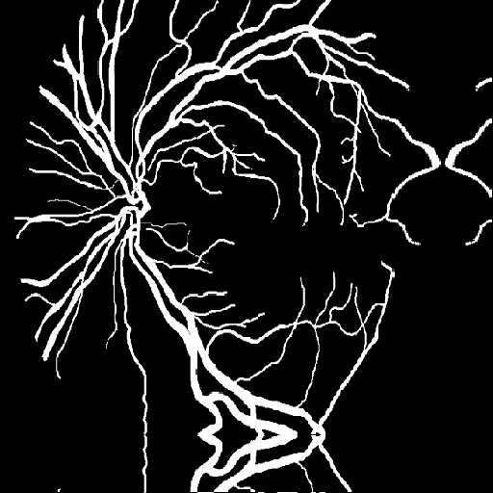
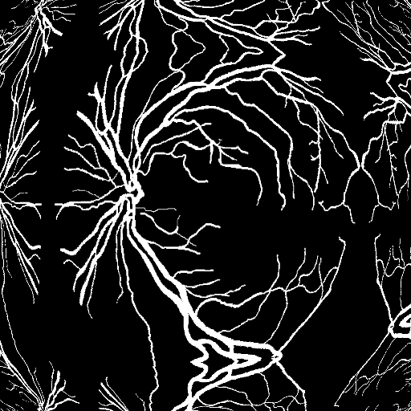
Data Modelling & Augmentation Results
Horizontal Flip
Vertical
Flip
Elastic
Transform
Grid
Distortion
Optical
Distortion

Slide 20
Data Loader Overview

Slide 21
Data Loader Overview
Split | Datasets Employed | Number of Fundus Scans
Training | 7 | 1608
Testing | 7 | 672
Validation | 1 | 5

Slide 22
Proposed Model Architecture

Slide 23
Proposed Model Architecture
As previously disclosed, a conventional UNet model was utilized to efficiently segment the retinal blood vessels spanning a given fundus image.
The presented UNet Model comprises of four distinct encoder and decoder blocks connected by a single convolution block that serves as a bottleneck layer in the model.
Moreover, the proposed convolution block includes two convolutional layers with a Scaled Exponential Linear Unit or 'SELU' activation function and a LeCun initializer , respectively.

Slide 24
Proposed Model Architecture
In addition, each combination of encoder and decoder blocks incorporates a discrete set of convolution blocks with a distinct set of input features.
Finally, a single convolutional Layer featuring a single neuron and a sigmoid activation function serves as the output layer for the provided model.

Slide 25
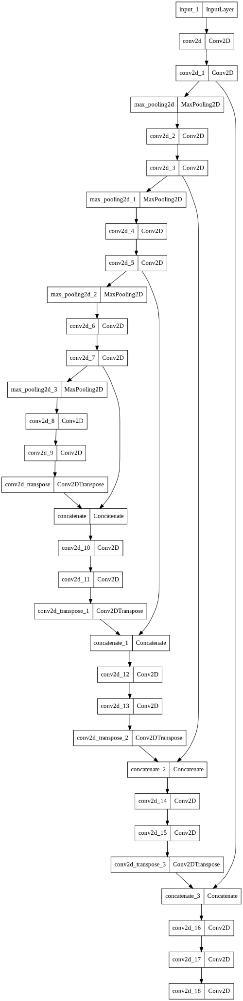
Proposed Model Architecture

Slide 26
Proposed Algorithm Design

Slide 27
Proposed Algorithm Design
Data Modelling Script
Model Analysis Script
Image Pre-processing
Multi GPU Check
Raw Dataset
Final Model Validation Script
Data Augmentation
Hyper Parameter Optimization
Model Files
Model Training & Validation

Slide 28
Proposed Algorithm Workflow Chart

Slide 29




Proposed Algorithm Workflow Chart
Raw Dataset
Vessels-Datasets.zip
Data Pre-Processing Script
Retina_Seg_reg.zip
UNet Model Training Script
Retina_seg.zip
UNet Model Evaluation Script
Model Prediction Chart

Slide 30
Model Metrics

Slide 31
Model Metrics
The suggested system was assessed largely utilizing various metrics dubbed Dice Similarity Coefficient, Dice Loss, Intersection Over Union Precision, and Recall.
The Dice similarity coefficient is a statistical tool that calculates the similarity between two sets of data, while the dice loss is calculated by subtracting the aforementioned dice coefficient by one.

Slide 32
Model Metrics
Furthermore, Intersection Over Union (IoU) is a number that measures the degree of overlap between two images, hence the measure is determined in the suggested project by assessing the overlap of the ground truth and projected region verified by the model.
Moreover, the model’s precision score, or ppv, is defined as the ratio of correctly classified positive samples (True Positive) to the total number of classified positive samples . Finally, the model's recalls score, or TPR, is defined as the model's ability to recognize positive samples.

Slide 33
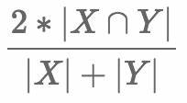


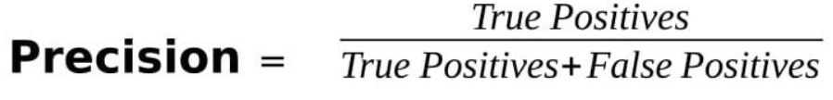
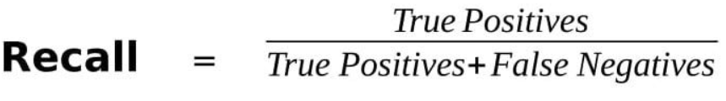
Model Metrics Formulae Chart
Dice Coefficient
Dice Loss
Intersection Over Union
Precision
Recall

Slide 34
Project Outcome & Demo
Model Results & Predictions
Conclusion & Future Scope
Project Demo

Slide 35
Model Results
Dice Loss
Intersection Over Union
Dice Coefficient
Precision-Recall

Slide 36
Dice Loss

Slide 37
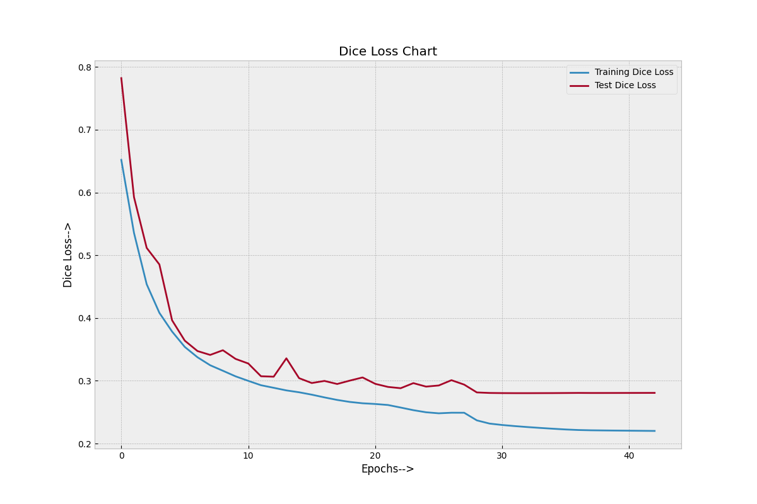
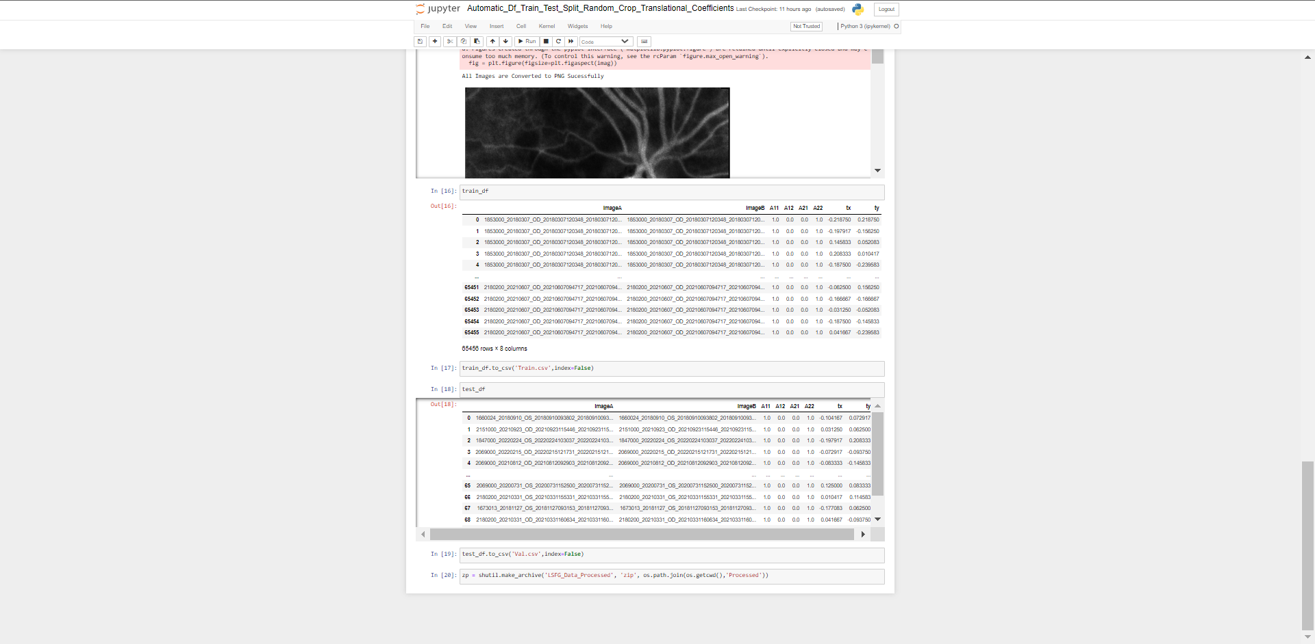
Dice Loss Results

Slide 38
Dice Coefficient

Slide 39
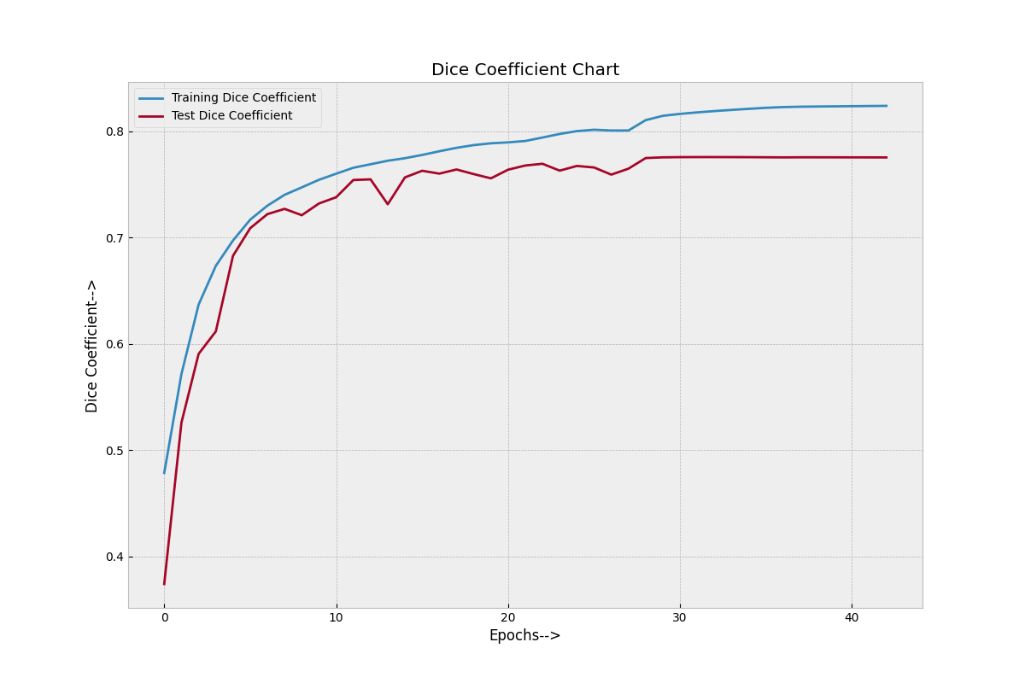
Dice Coefficient Results

Slide 40
Intersection Over Union

Slide 41
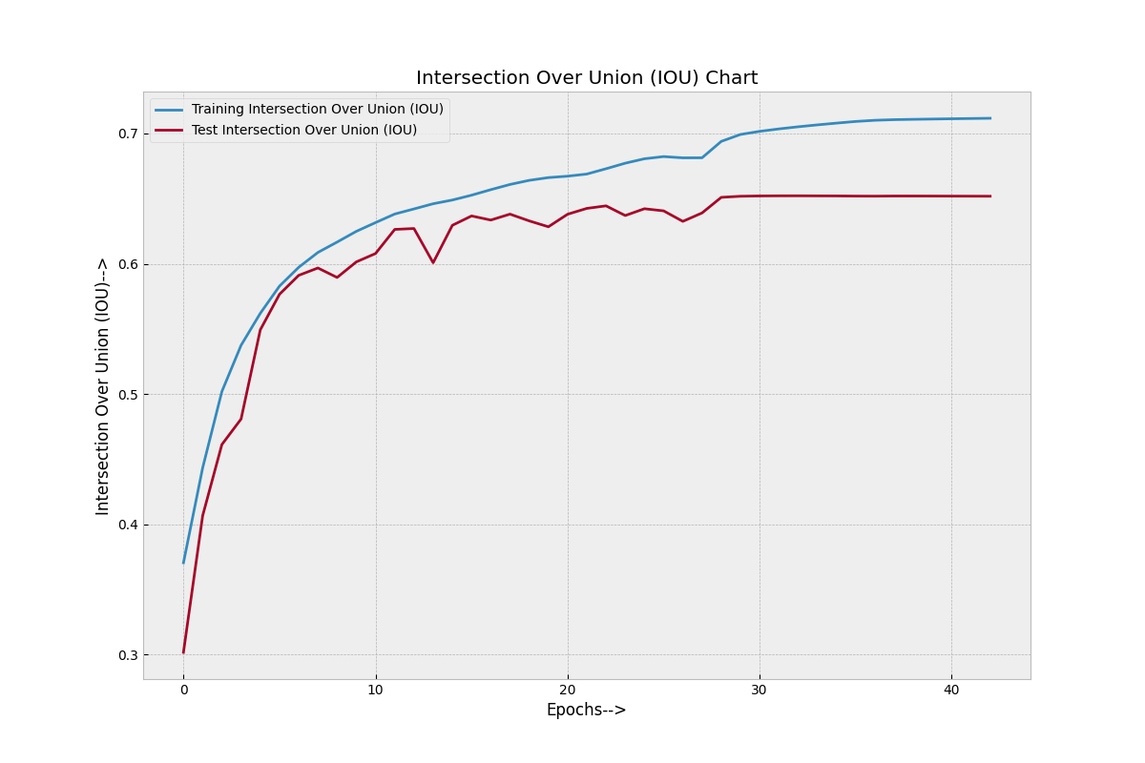
Intersection Over Union Results

Slide 42
Precision- Recall

Slide 43
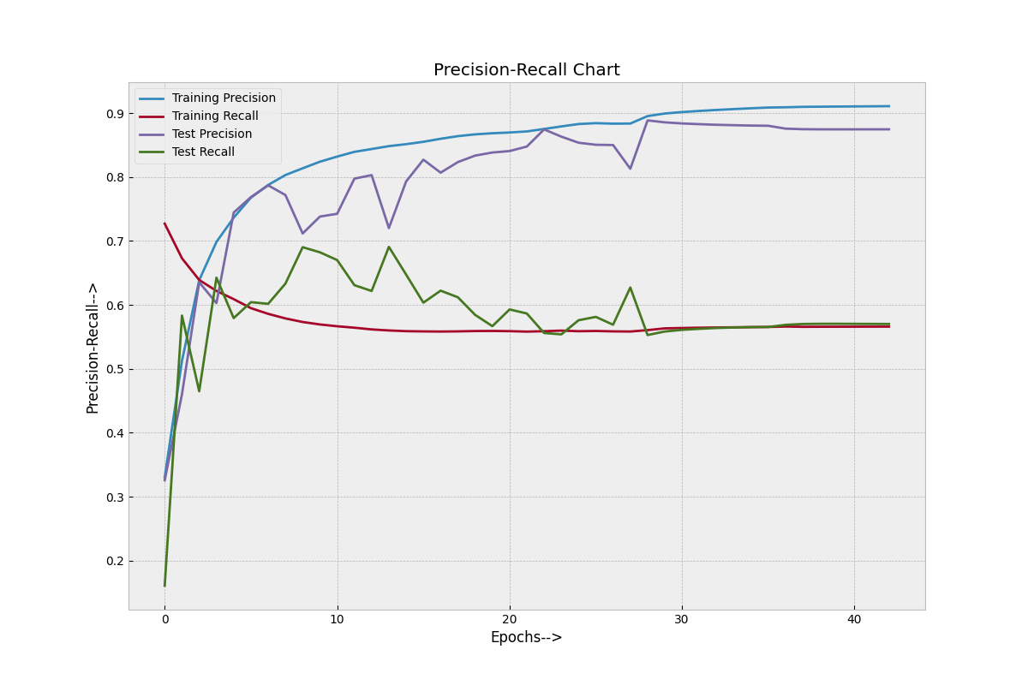
Precision- Recall Results

Slide 44
Model Prediction

Slide 45
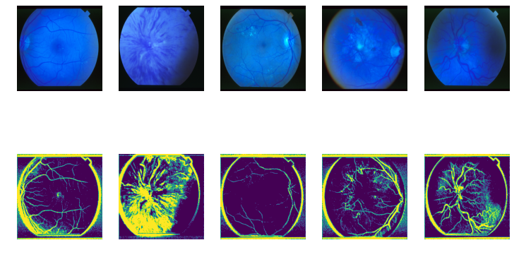
Model Prediction

Slide 46
Conclusion & Future Scope

Slide 47
Conclusion & Future Scope
Based on the results, it is possible to conclude that the proposed model framework outperforms state of the art deep learning models in terms of segmenting the Retinal Blood Vessels with ease and efficiency on the presented datasets.
In addition, the proposed model framework was trained on a Multi GPU Framework (i.e. trained on five GPU's), substantially reducing the time required for training and validating the model while augmenting its performance.

Slide 48
Conclusion & Future Scope
Nevertheless, there is still room for advancement; consequently, one significant enhancement would be to expand the scope of the model, i.e., train and validate the proposed model framework on a vast variety of datasets to promote diversity while preserving model integrity.

Slide 49
Project Demo

Slide 50
Thank You

